Slide 1
Segmentation and Scoring Application
Functional Overview
Application Version 2.0
Last Updated February 2026

Slide 2
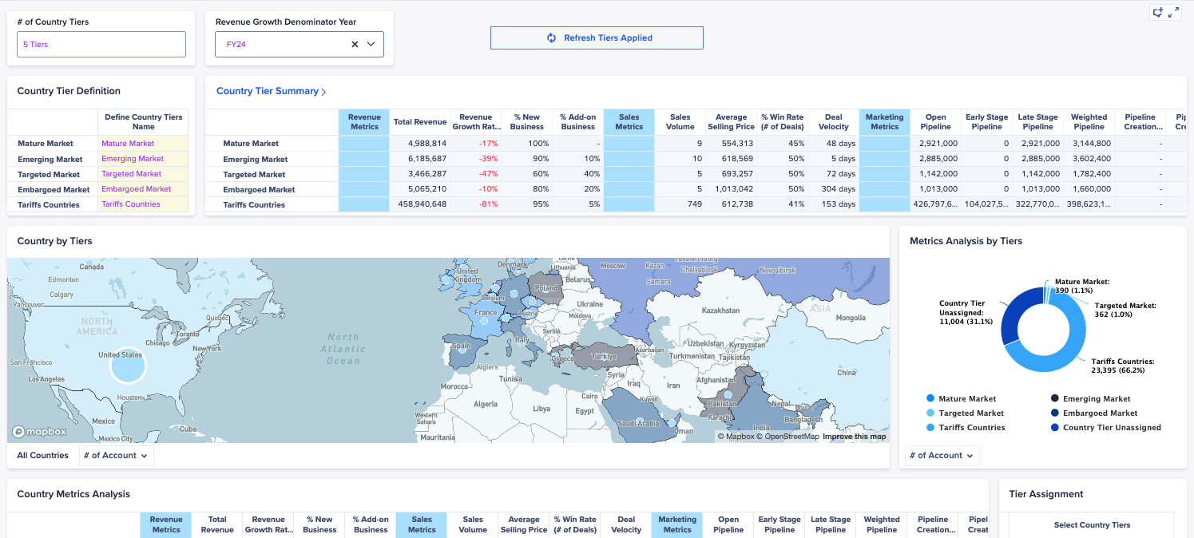
Segmentation and Scoring Application
OVERVIEW
Anaplan's Segmentation and Scoring Application helps organizations identify high-revenue opportunities, optimize go-to-market strategies, and allocate investments effectively to increase productivity, maximize revenue, and reduce operational costs and risk.
KEY CAPABILITIES
Holistic market analysis across segments, products, and services.
Ideal customer profile planning to normalize account planning data and sub-segmentations across teams.
Top-down market sizing to identify remaining wallet share and optimal go-to-market strategies
Rule-based and account segmentation and scoring to prioritize the right customers.
Scenario-based GTM hierarchy planning to model next year's GTM coverage model
Embedded workflows to capture account knowledge, feedback, approvals, and overrides.
Notes:
We realize some of you might not be Segmentation expert and we want to provide you some context before we dive into the UAT specific.
The Segmentation and Socring process is process of scoring and categorizing account into different tiers to ensure that these accounts receive the appropriate lvl of coverage. This foundation of GTM planning process that guides resource allocation, territory design, and quota setting.
The App enables you to do Market Analysis
Define your Ideal Customer Profile
Do Top-down market sizing
Rule Based and Scoring Segmentation
It also incorporates workflow for feedback loop and approval process
I will provide you recording of the pages to give you context for UAT

Slide 3
Anaplan Segmentation and Scoring Application
Out-of-the-box
Market Analysis
Analysis of GTM, country, product, and service performance and tiers
Key Benefits:
Historical, forecasted, and predictive market performance and account potential in one place.
Repeatable market and wallet sizing methodologies, and account segmentation and scoring processes.
Evaluate trade-offs and make trusted granular decisions faster.
Gather data, account knowledge, feedback, approvals, and overrides to get effective plans out on-time.
Align your go-to-market strategies, plans, and teams to markets and accounts with the highest revenue potential
Ideal Customer Profile Definition
Set exclusionary criteria to eliminate data noise in downstream planning
Account hierarchy management
Establish account roll-ups to a parent, flat hierarchies, or manage by exception
Wallet Sizing
Identify Service Obtainable Market (SOM) and remaining wallet share to drive go-to-market strategies
Account Segmentation and Scoring
Rule and scoring based segmentation
GTM Planning
Model next year's hierarchy and coverage model
Approvals, Overrides, and Distribution
Gather account knowledge, feedback, and plan approvals

Slide 4
Anaplan Segmentation and Scoring Application
Out-of-the-box
Market Analysis
Analysis of GTM, country, product, and service performance and tiers
Key Benefits:
Historical, forecasted, and predictive market performance and account potential in one place.
Repeatable market and wallet sizing methodologies, and account segmentation and scoring processes.
Evaluate trade-offs and make trusted granular decisions faster.
Gather data, account knowledge, feedback, approvals, and overrides to get effective plans out on-time.
Align your go-to-market strategies, plans, and teams to markets and accounts with the highest revenue potential
Approvals, Overrides, and Distribution
Gather account knowledge, feedback, and plan approvals
Ideal Customer Profile Definition
Set exclusionary criteria to eliminate data noise in downstream planning
Account Segmentation and Scoring
Rule and scoring based segmentation
Account hierarchy management
Establish account roll-ups to a parent, flat hierarchies, or manage by exception
Wallet Sizing
identify Service Obtainable Market (SOM) and remaining wallet share to drive go-to-market strategies
GTM Planning
Model next year's hierarchy and coverage model
Notes:
These are the big functional areas you will test in the generated application
Starting from the top

Slide 5
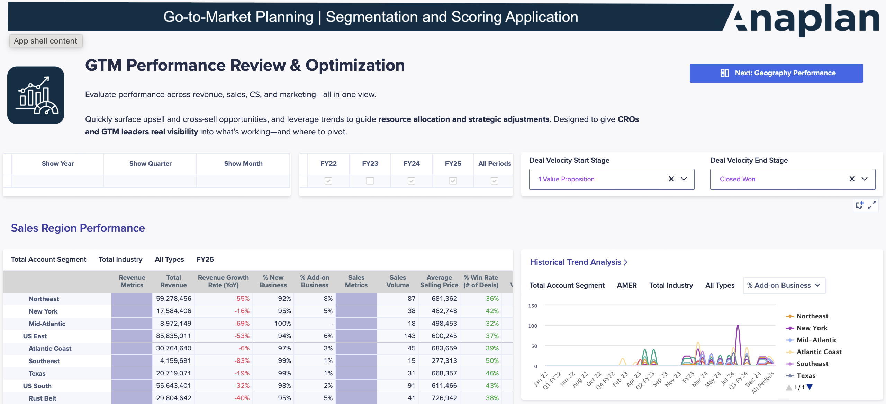
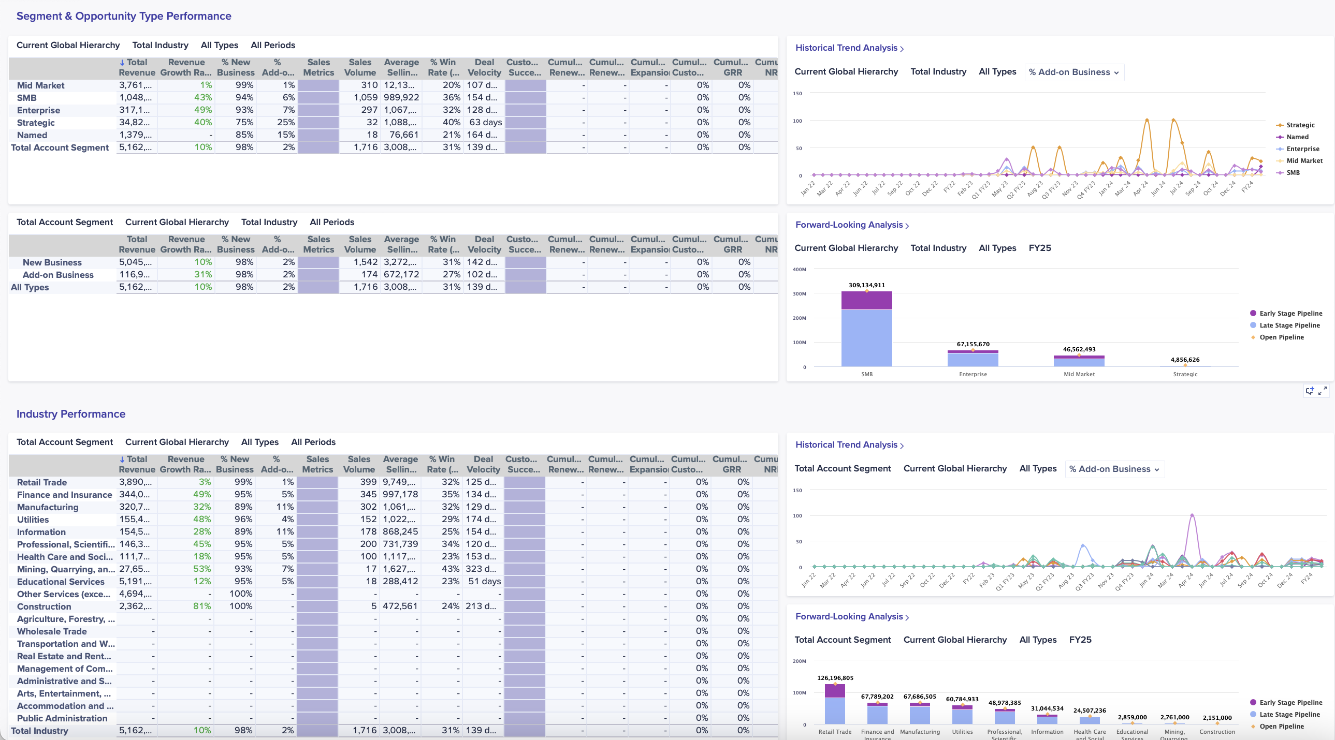
Segmentation and Scoring Application
GTM Performance Review & Optimization
Analyze GTM performance across configurable dimensions
Support revenue, sales, CS, and marketing metrics for CRO visibility
Uncover upsell and cross-sell opportunities by segment or region
Use trend insights to optimize resource allocation and strategy

Slide 6
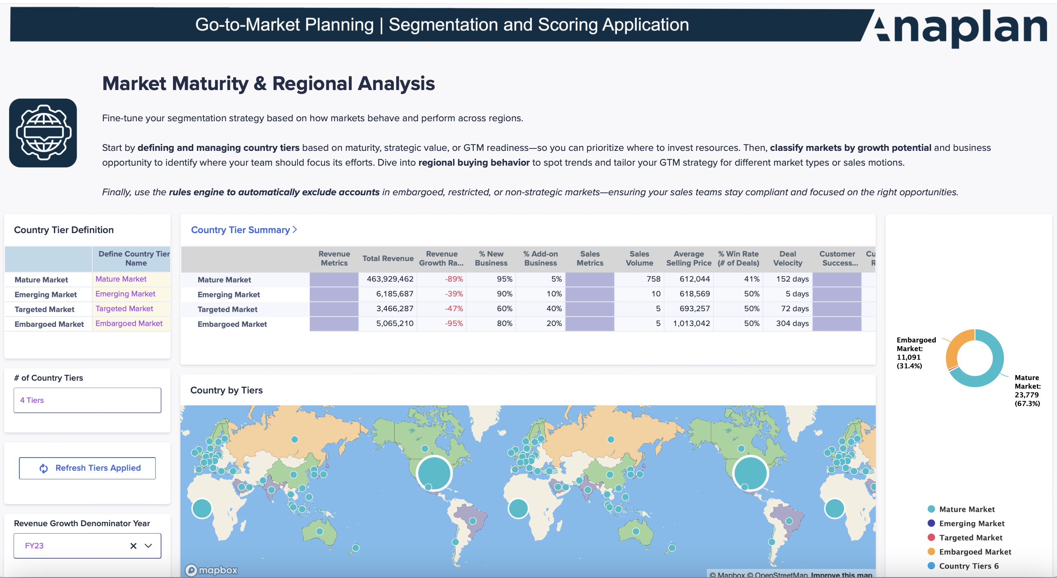
Segmentation and Scoring Application
Market Maturity & Regional Analysis
Define and manage country tiers by maturity or strategic value
Classify markets by maturity and growth potential
Analyze regional buying behavior to inform segmentation
Use rules-engines to exclude accounts from targeting (e.g., embargoed or restricted markets)

Slide 7
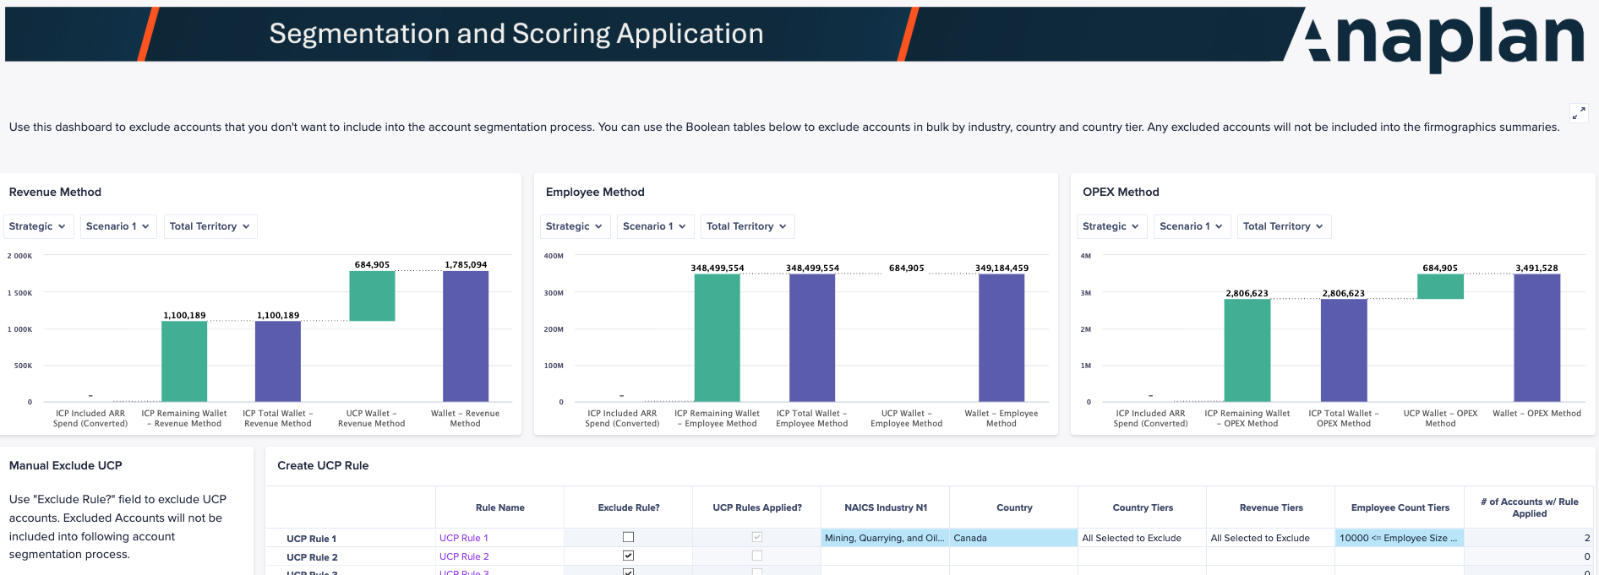
Segmentation and Scoring Application
Unacceptable Customer Profile (UCP) Identification
Exclude accounts based on criteria like country tier, industry, revenue, or size
Assess how exclusions impact total wallet size
Prioritize high-potential accounts for segmentation and planning

Slide 8
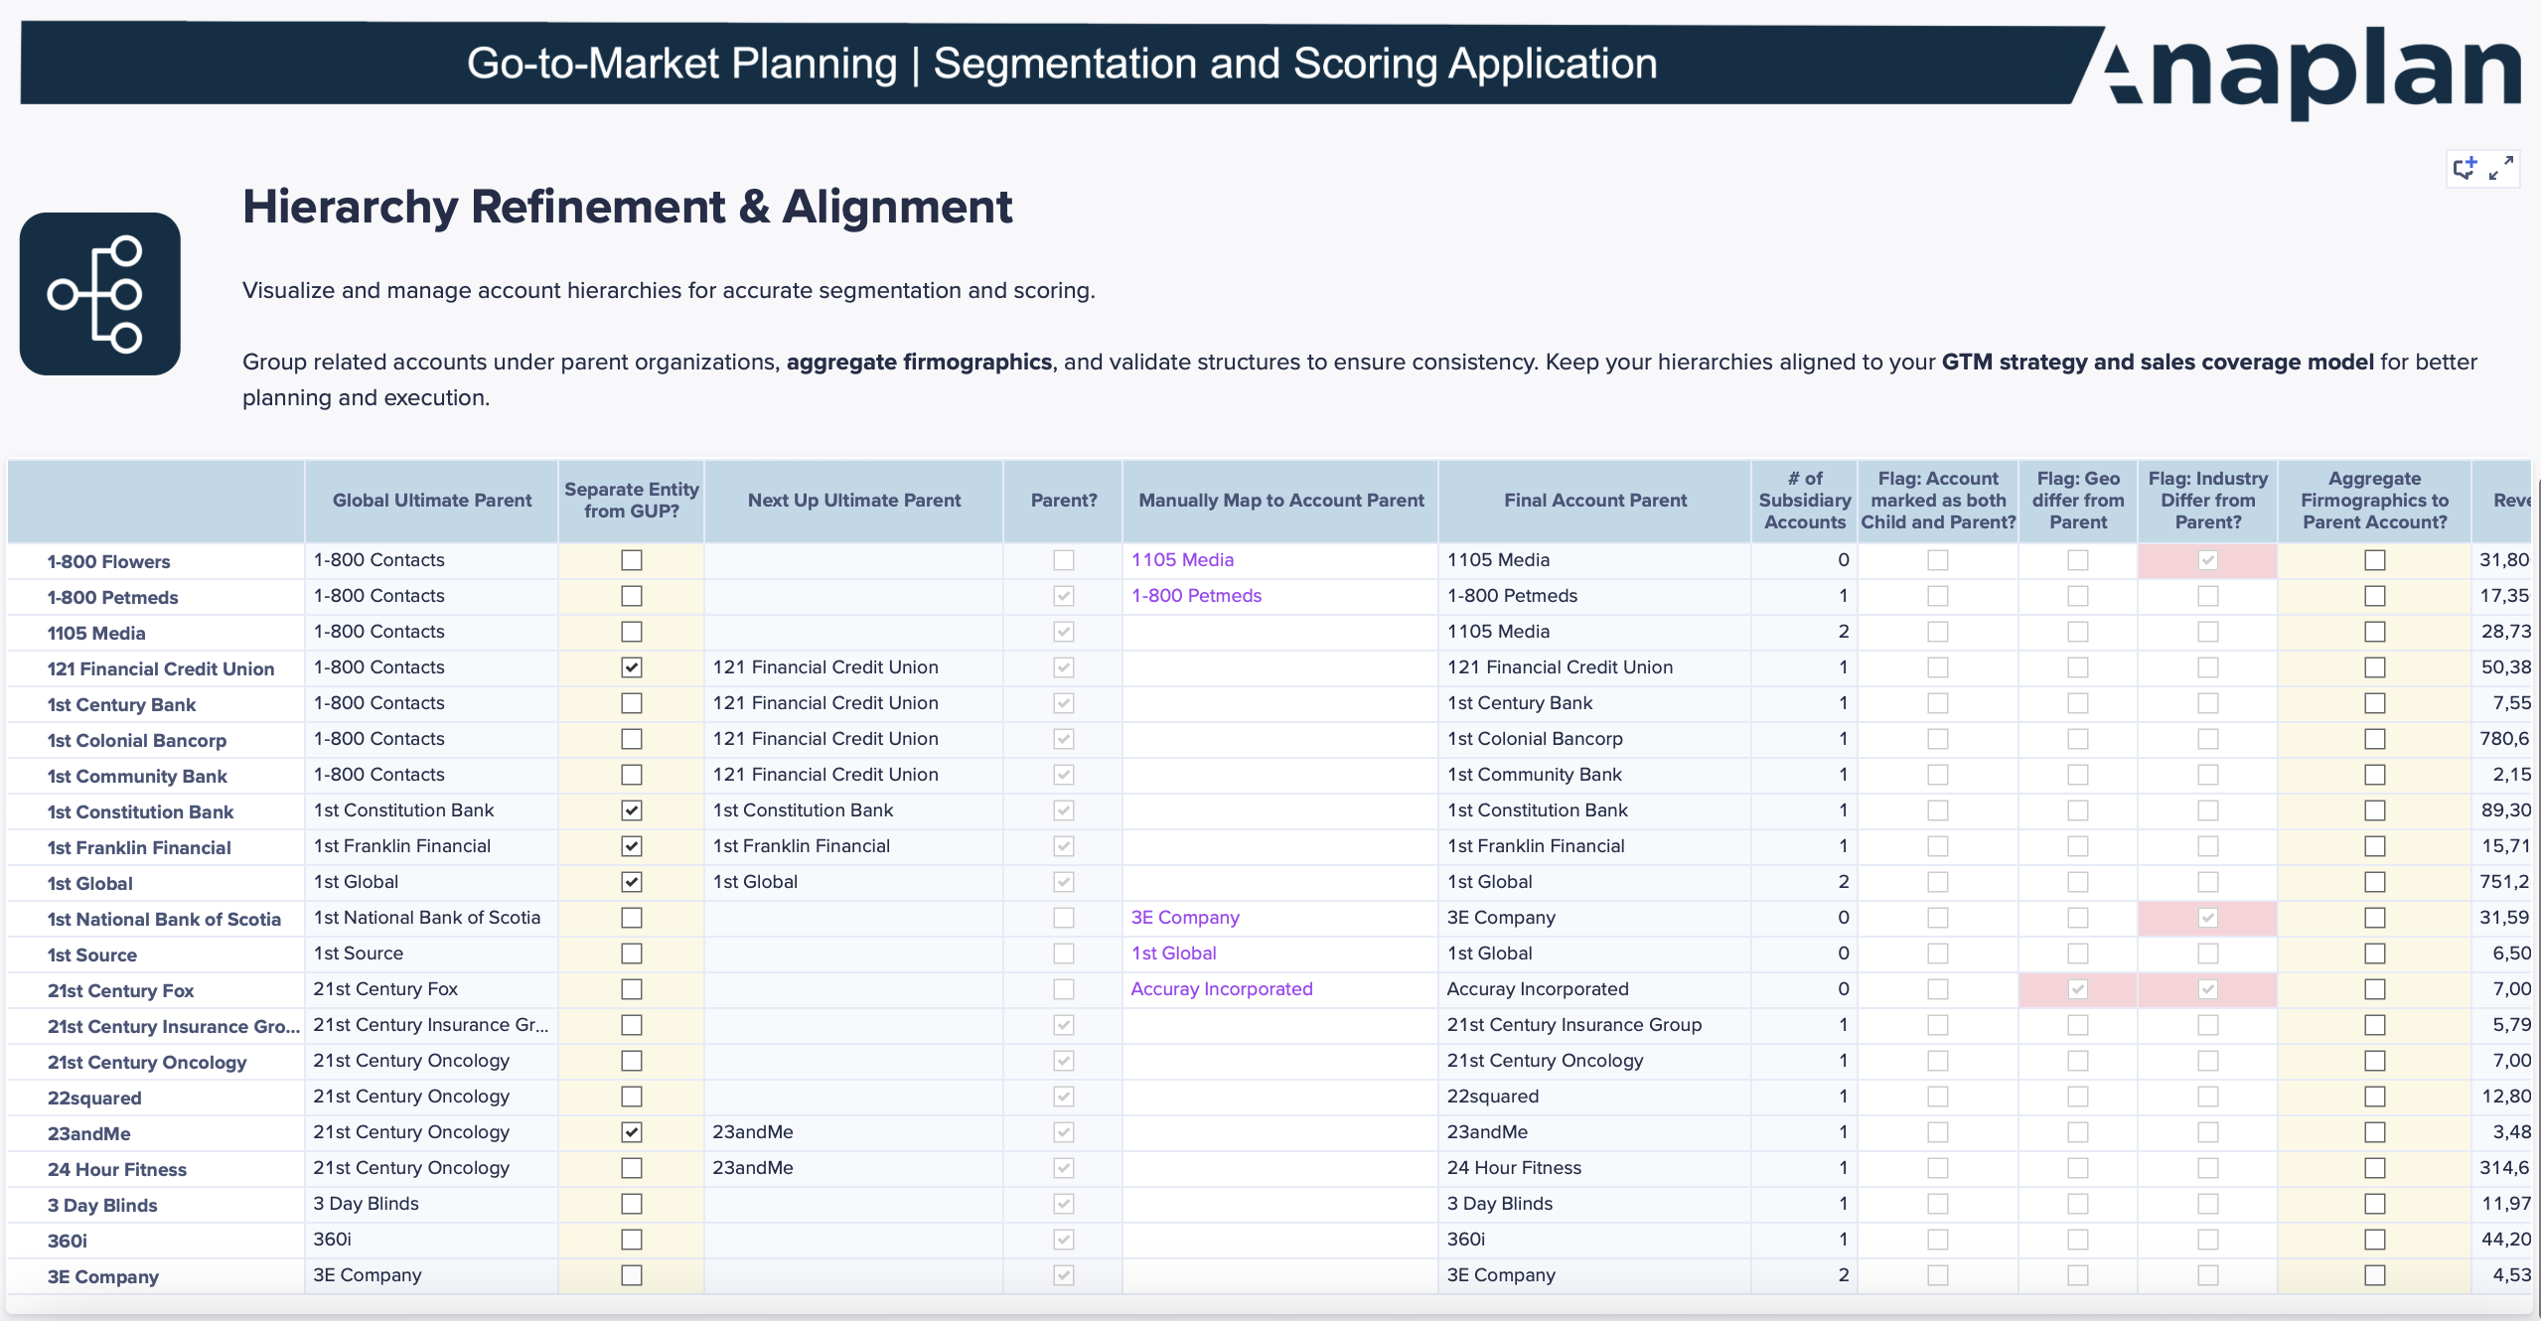
Segmentation and Scoring Application
Account Hierarchy Refinement
Visualize and manage account hierarchies for greater clarity
Aggregate firmographic data to improve scoring accuracy
Refine structures and group accounts under parent organizations
Ensure hierarchy accuracy and alignment with GTM strategies

Slide 9
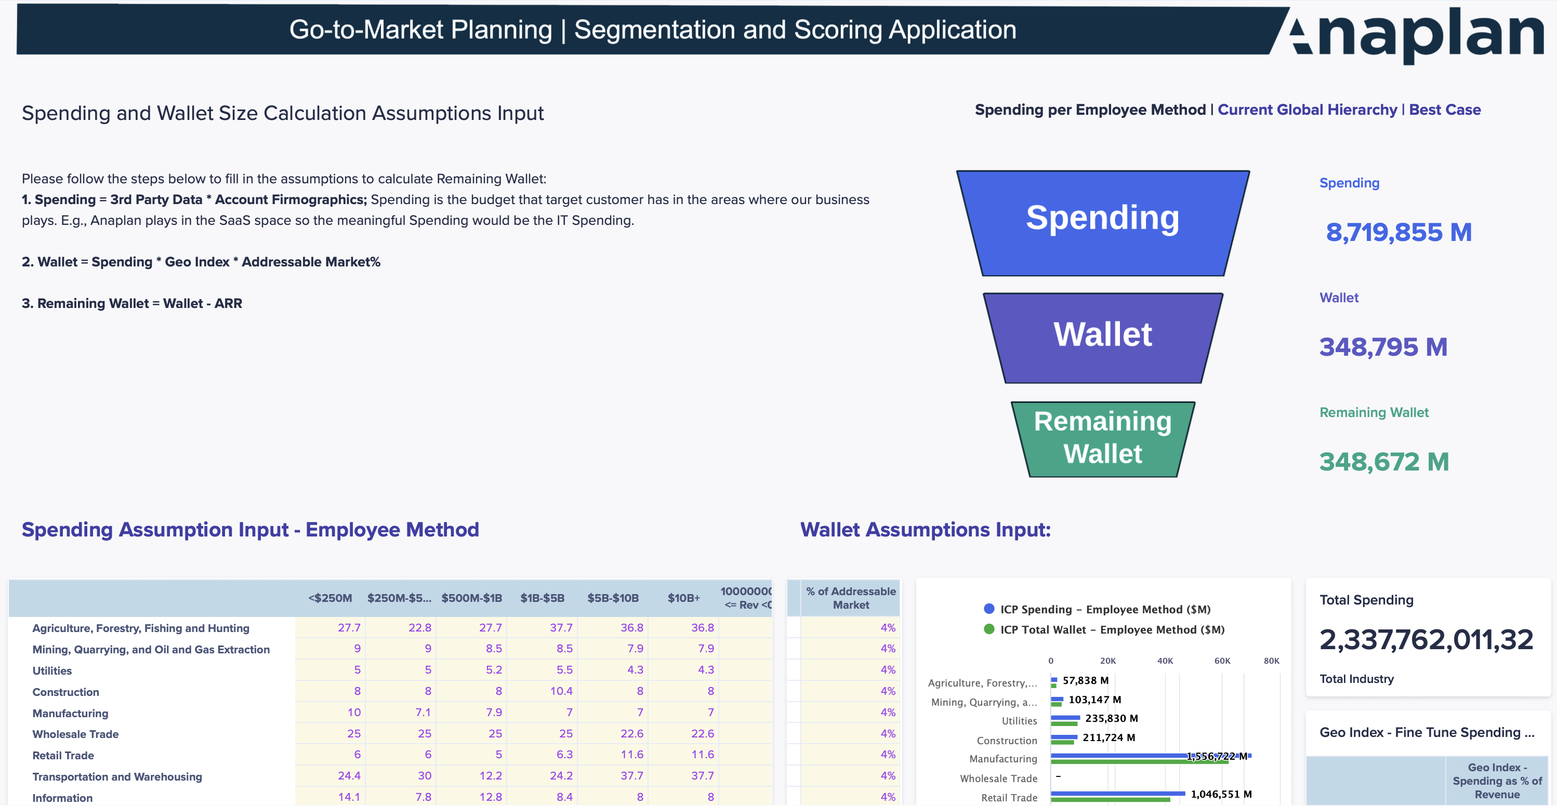
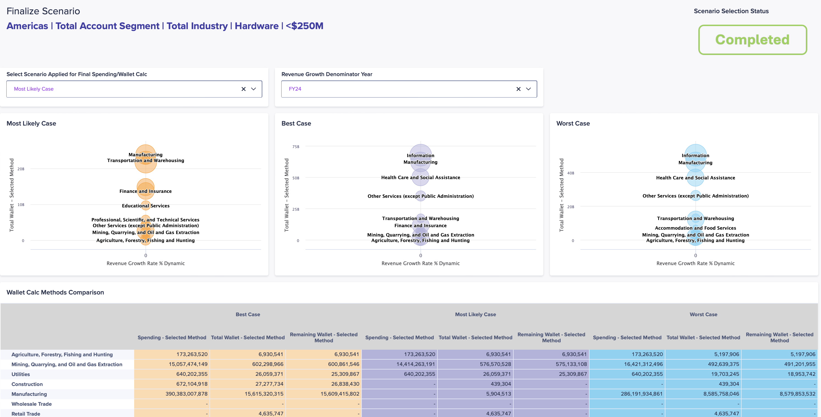
Segmentation and Scoring Application
Wallet Size Modeling & Management
Support multiple methodologies, including Analyst-aligned models
Select best-fit approaches by industry, segment, or region
Model scenarios to project wallet size by account or group
Identify and manage outliers for cleaner analysis
Incorporate approval workflows for final wallet size validation

Slide 10
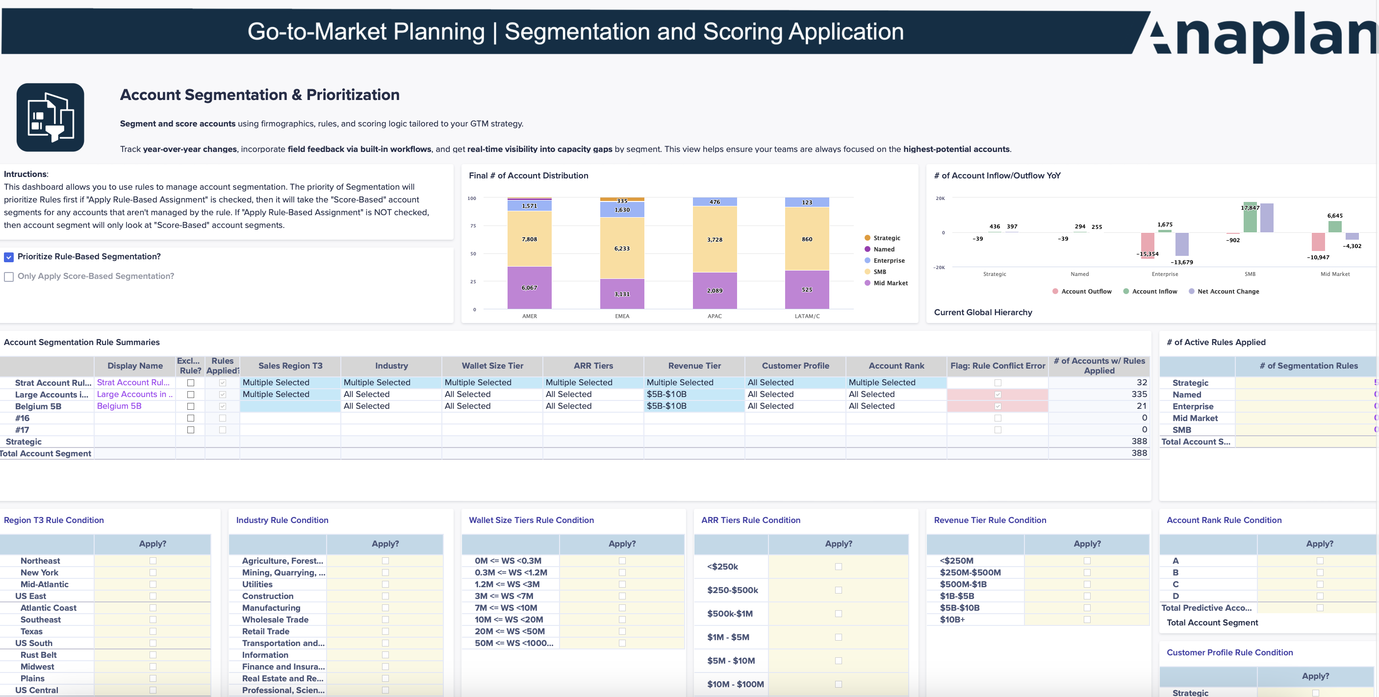
Segmentation and Scoring Application
Account Segmentation & Prioritization
Profile accounts using firmographics and other key attributes
Segment accounts using rule-based and scoring logic
Configure scoring models to fit your GTM strategy
Track Year-over-Year changes to segment composition and performance
Incorporate field feedback with built-in workflows
Gain real-time visibility into capacity gaps by segment

Slide 11
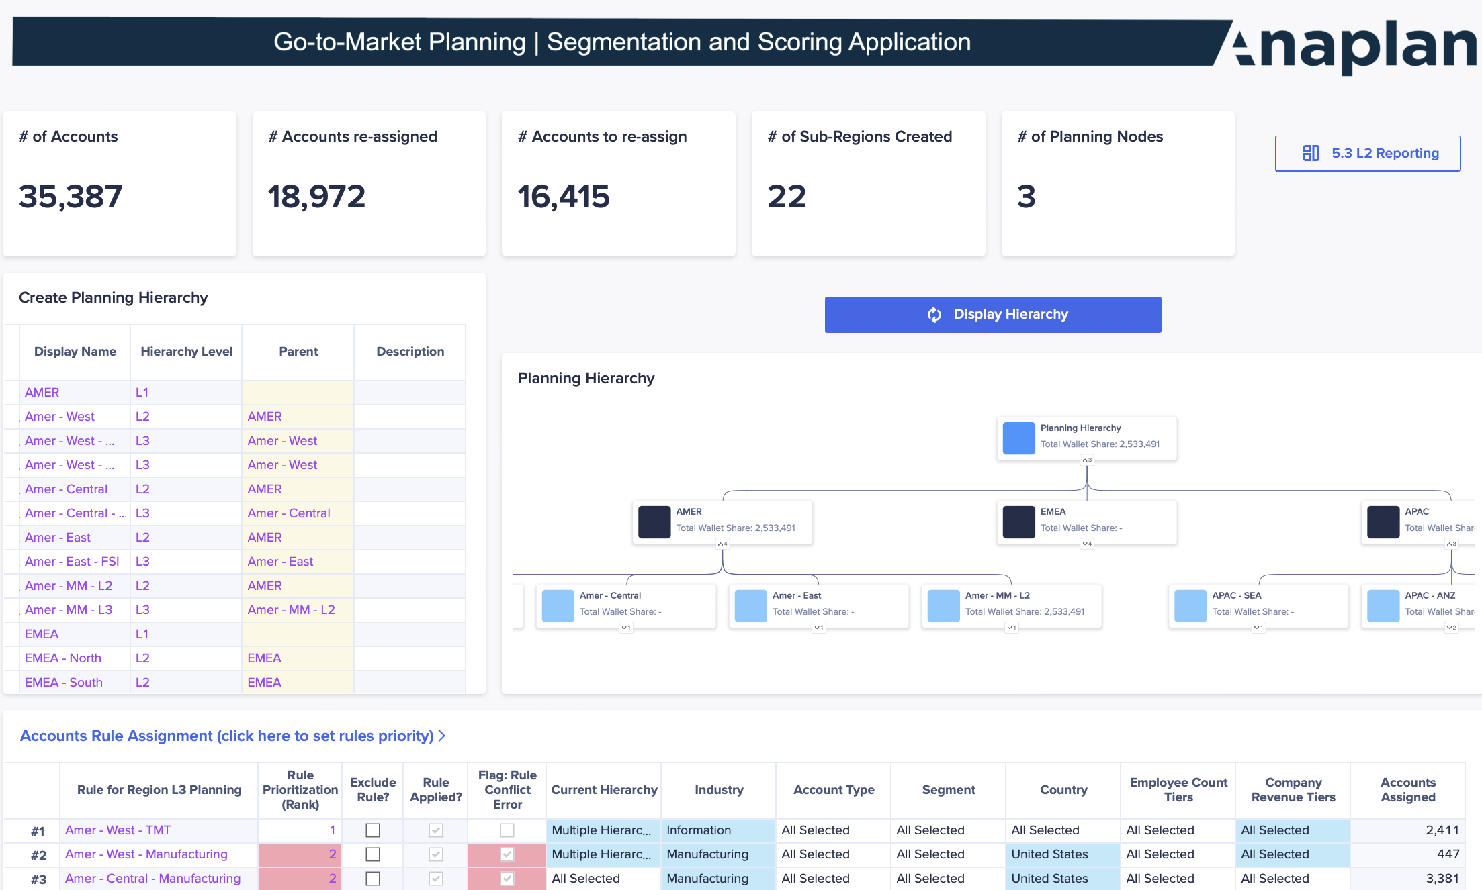
Segmentation and Scoring Application
GTM Strategy & Scenario Planning
Define and manage sales hierarchies to support evolving GTM models
Apply account assignment rules to simulate structural changes
Visualize KPIs by new hierarchy to assess strategic impact before rollout
Finalize GTM Planning scenario to pass to downstream systems

Slide 12

Anaplan Segmentation and Scoring Application – Summary
Market Maturity Analysis
Ideal Customer Profile (ICP)
& Wallet Sizing
  Define and manage country tiering based on maturity and growth potential
  Classify markets by expansion potential and buying behavior
  Identify restricted or embargoed markets and assess impact
  Support multiple Wallet Size methodologies
  Identify the best methodology by industry
  Model Wallet Size scenarios and highlight outliers
  Incorporate approval workflows for Wallet Size calculations
GTM Performance Review
Segmentation and Scoring
Hierarchy Refinement
  Perform in-depth GTM analytics with configurable dimensions
  Track sales, CS, and marketing metrics for CRO insights
  Identify upsell and cross-sell opportunities
  Optimize resource allocation using trend analysis
  Visualize and refine account hierarchies for accuracy
  Aggregate firmographics to improve account scoring
  Group accounts by parent organization for easy GTM execution
  Align hierarchies with GTM strategies to ensure consistency
Account Segmentation
  Profile customers using key attributes and firmographics
  Segment accounts using a rule-based engine
  Implement scoring-based segmentation models with configurable metrics
  Track year-over-year segmentation changes
  Gather and manage field feedback through streamlined workflows
  Identify capacity gaps in real-time when changing segments
Ideal Customer Profile (ICP)
GTM Strategy (Scenario Planning)​
  Exclude accounts based on predefined attributes (e.g., region, size) based on ICP
  Assess the impact of excluded accounts on Wallet Size
  Prioritize high-potential accounts for planning focus
  Leverage account assignment rule to validate go-to-market strategies
  Visualize KPIs by new sales hierarchy to compare performance impact

